Slide 1
Horizon Cloud, Building Operator IC

Slide 2
A) Models
B) Software Test Architecture
SECTION 1
Test Models
System Models
Correlation
Limits & Advantages
Description of the system
Architecture diagram
Test Infrastructure & Test Frameworks

Slide 3
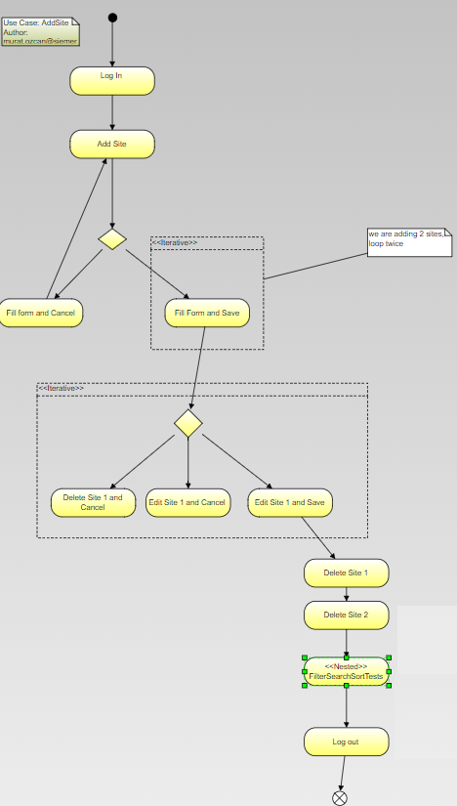
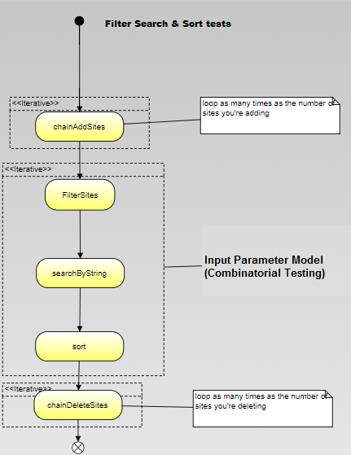
A 1) Test Models > Activity Diagrams
Add Site Activity Diagram & Test Design https://code.siemens.com/horizon/facility-manager-ba/documentation/blob/master/test-designs/e2e/add-site.td.md

Slide 4
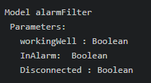
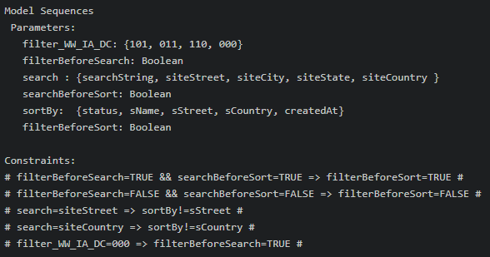
A 1) Test Models > Input Driven Parameter Models: Combinatorial Testing
Add Site CT IPM & Test Design https://code.siemens.com/horizon/facility-manager-ba/documentation/blob/master/test-designs/e2e/add-site.td.md

Slide 5
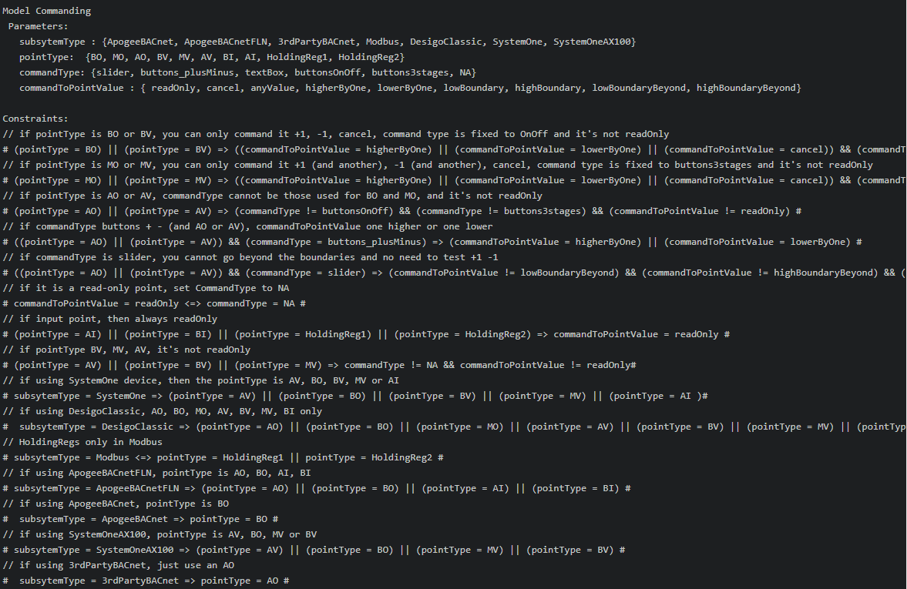
A 1) Test Models > Input Driven Parameter Models: Combinatorial Testing
Point Command CT IPM & Test Design https://code.siemens.com/horizon/facility-manager-ba/documentation/blob/master/test-designs/e2e/point-command.td.md

Slide 6
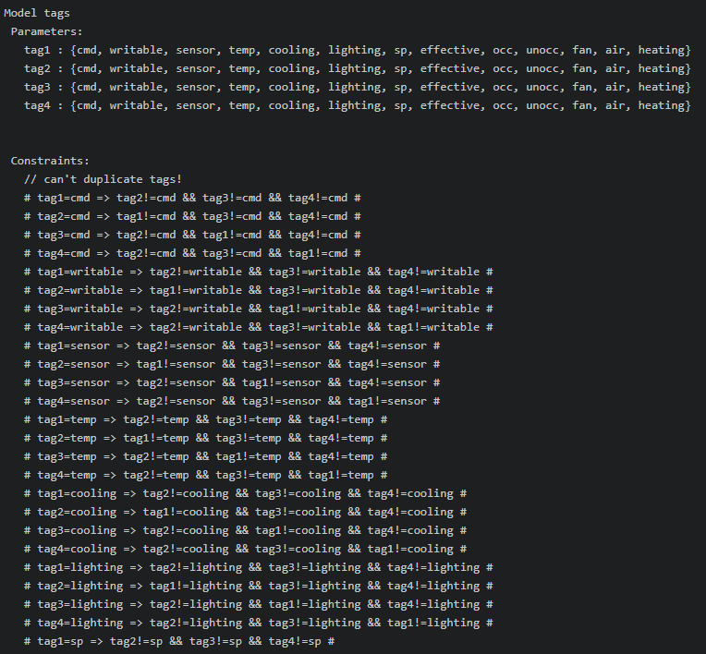
A 1) Test Models > Input Driven Parameter Models: Combinatorial Testing
Tag Filter CT IPM & Test Design https://code.siemens.com/horizon/facility-manager-ba/documentation/blob/master/test-designs/e2e/tag-filter.td.md

Slide 7
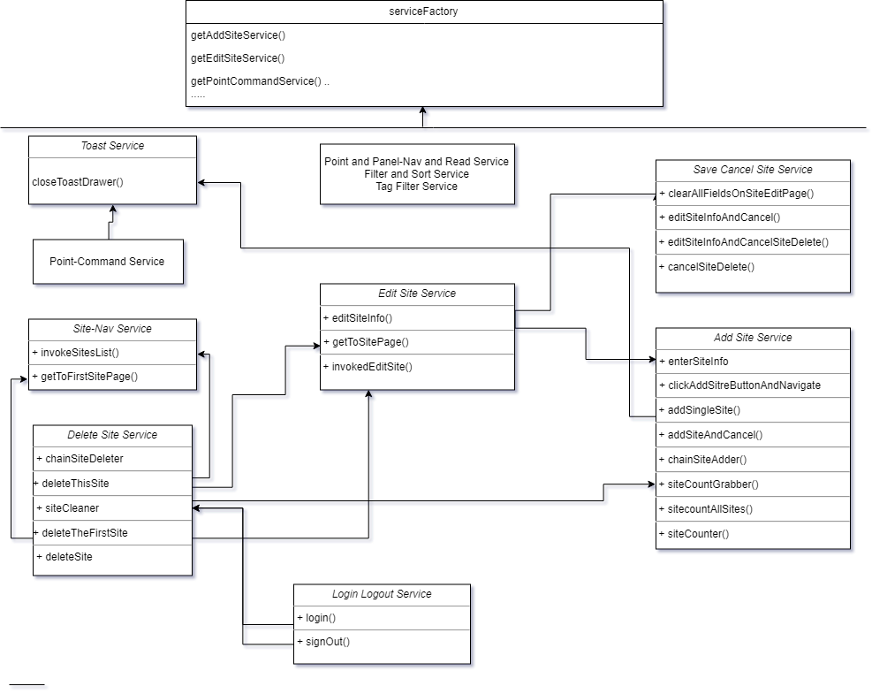
A 2) System Models > (Test)Service Factory: dependency inversion with abstract class
https://code.siemens.com/horizon/facility-manager-ba/ui-building-operator-ic/blob/master/e2e/services/service-factory.ts

Slide 8
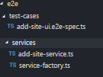
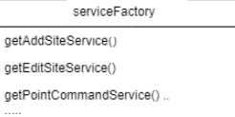



A 3) Correlation > System Model (test services) are used to build e2e tests
https://code.siemens.com/horizon/facility-manager-ba/ui-building-operator-ic/blob/master/e2e/services/service-factory.ts
add-site-ui.e2e-spec.ts

Slide 9
A 4) Limits and advantages
The models (CT IPM or Activity) do not generate code.
All code is written in BDD format, manually
Traceability is documented in test designs:
T.D. Overview -> User Story reference
T.D. Test Scenarios -> reference to manually created BDD verbiage in automated tests
T.D. Approach refinements -> Model description.

Slide 10
B) Software Test Architecture
Description of the system
Architecture diagram
Test Infrastructure & Test Frameworks

Slide 11
B 2) Description of the system
Horizon Cloud provides widespread connectivity to legacy & new controls, 3rd party, IoT,
edge devices and a step-wise covering of on-site, real-time requirements.
Horizon Cloud features its own apps based on building integration framework, along with
themes, with an open API for ecosystem and SSP.
The program also provides a common data model and API to BT Building Integration
Framework to map southbound data against model.

Slide 12
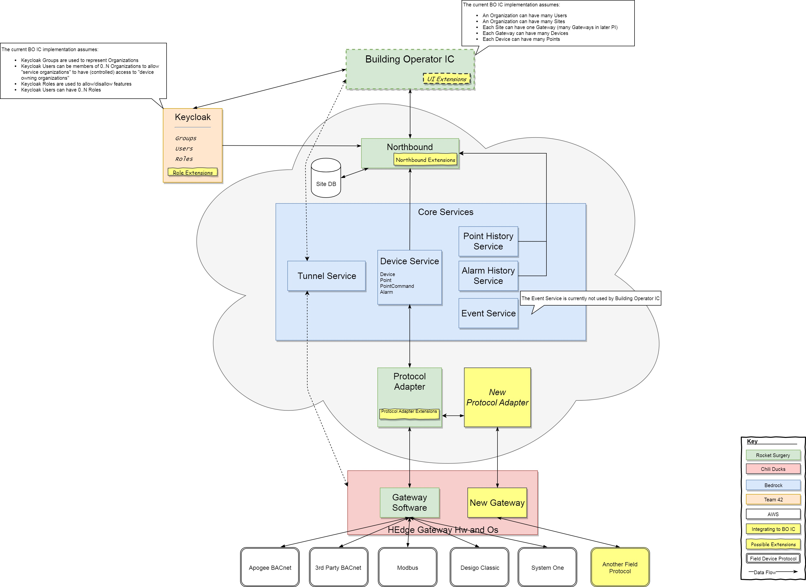
B 1) High Level Architecture Diagram
https://code.siemens.com/horizon/facility-manager-ba/documentation/blob/master

Slide 13
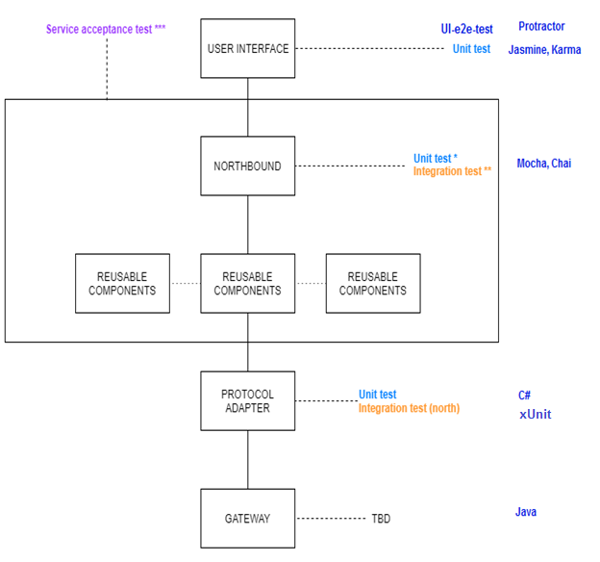
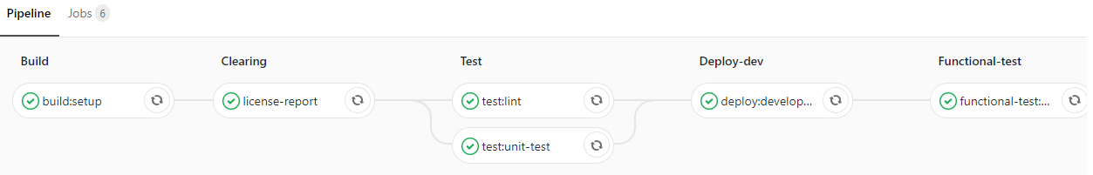
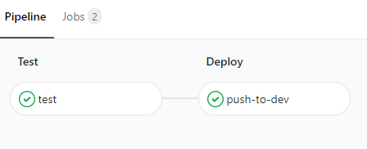
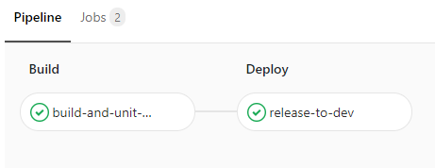
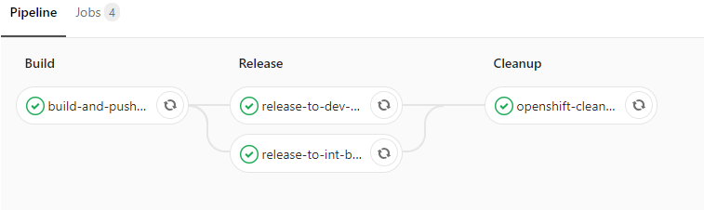
B 3) Test Infrastructure | Test Frameworks | DevOps

Slide 14
C) Architecture
D) The most important NFR
SECTION 2
Specify
Design
Implement
Governence
(execute, operate, maintain)
Developer habitability vs cost
Test approach

Slide 15
C) Architecture : Specify, Design, Implement, Govern
Specify: Based on a prototype SIMPL team created – not entirely green-field
Design: constraining possibilities vs providing least amount of constraints
Ex: Authentication of users : SiemensID vs KeyCloak
Implement: work from skill base of talent
Front-end devs that know JS -> use NodeJS + ExpressJS for the back-end
Governance
Co-locate teams, easier governance, face to face, peer reviews

Slide 16
D) The most important NFR: Developer Habitability vs Cost
Event-based architecture (decoupled, asynchronous) vs Transactional (traditional, synchronous)
Ex: Buying tickets from Ticket Master : lock the tickets during the transaction, for 2 minutes
PL’s are concerned about the cost
Test approach:
User : “no bugs!”
Process zealot : “academic goals!” “PEP!!”

